Slide 1
ASSOCIATION RULE MINING ON US - CENSUS DATA
Instructor : Dr. Longzhuang Li
Presented by
Vinay Datta pinnaka
Naveen chada

Slide 2
OUTLINE
Objectives
Data set description
Rule mining process
Resulting rules
Recommendations
Performance Comparison

Slide 3
OBJECTIVES
Domain - US census data
Dataset Description - This data set contains weighted census data extracted from the Current Population Surveys conducted by the U.S. Census Bureau
Number of instances -- 199523
Number of attributes – 17
Size of the data file is 52.7 MB

Slide 4
Benefits derived from Association rule mining
Employment status of the entire population in United states.
Education levels of normal US citizen.
Taxable income amount range for individuals.
Female Entrepreneurs in United states

Slide 5
DATASET ATTRIBUTES
Age
Class of the worker
Education
Marital status
Occupation
Race
Hispanic origin
Sex
Member of a labor union
Reason for un employment
Full or part time status
Tax filer stat
Detailed household summary in household
Instance weight
Country of birth self
Citizenship
Own business or self employed
Tax Income

Slide 6
DATA PREPROCESSING
Missing values are replaced with most occurring label
Instances with duplicate values for multiple attributes are discarded
Continuous attributes are removed while processing with WEKA

Slide 7
Rule Mining Process – Spark MLlib
Machine Information | Local machine using maven | Local machine using spark submit | Spark standalone cluster with client deploy | YARN cluster using spark submit
Specifications | One node with default settings | One node default settings | 40 cores, 4GB memory | Sbatch job submission

Slide 8
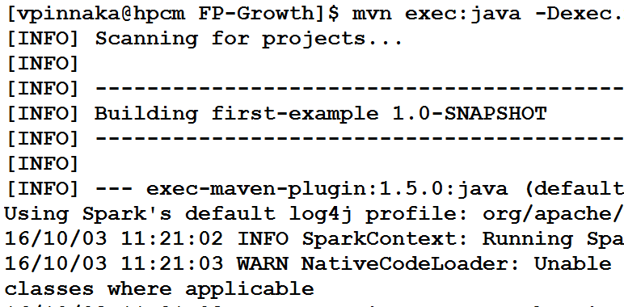
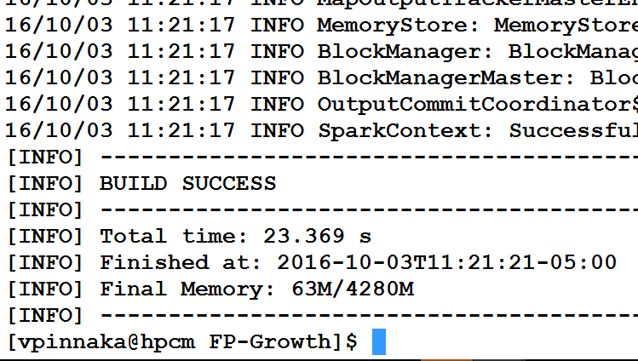
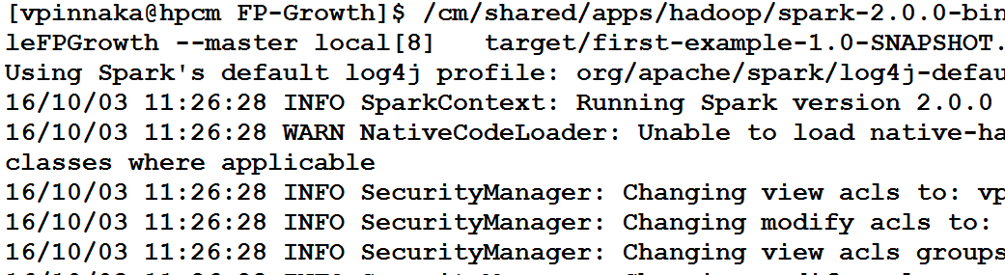
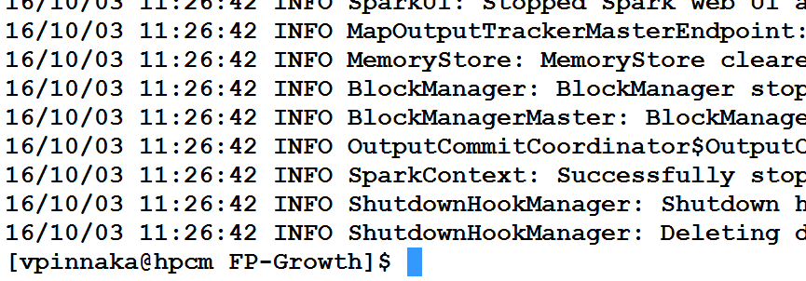
Fig: Local machine using maven
Fig: Local machine using spark submit

Slide 9
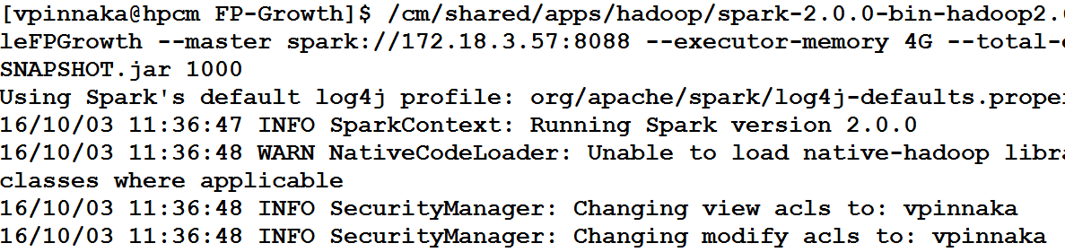
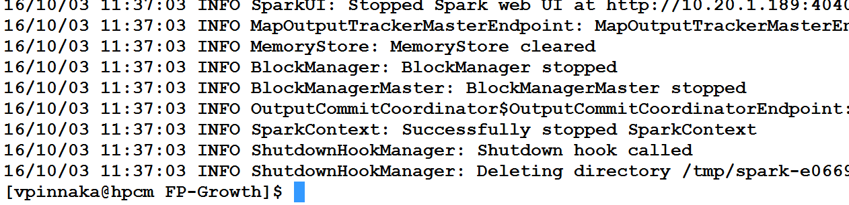
Fig: Spark standalone cluster with 40 cores

Slide 10
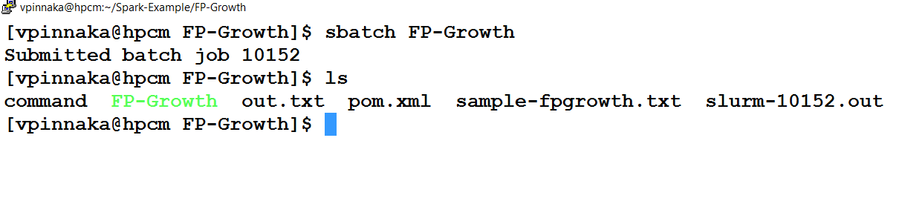
Fig: YARN cluster using sbatch submit

Slide 11
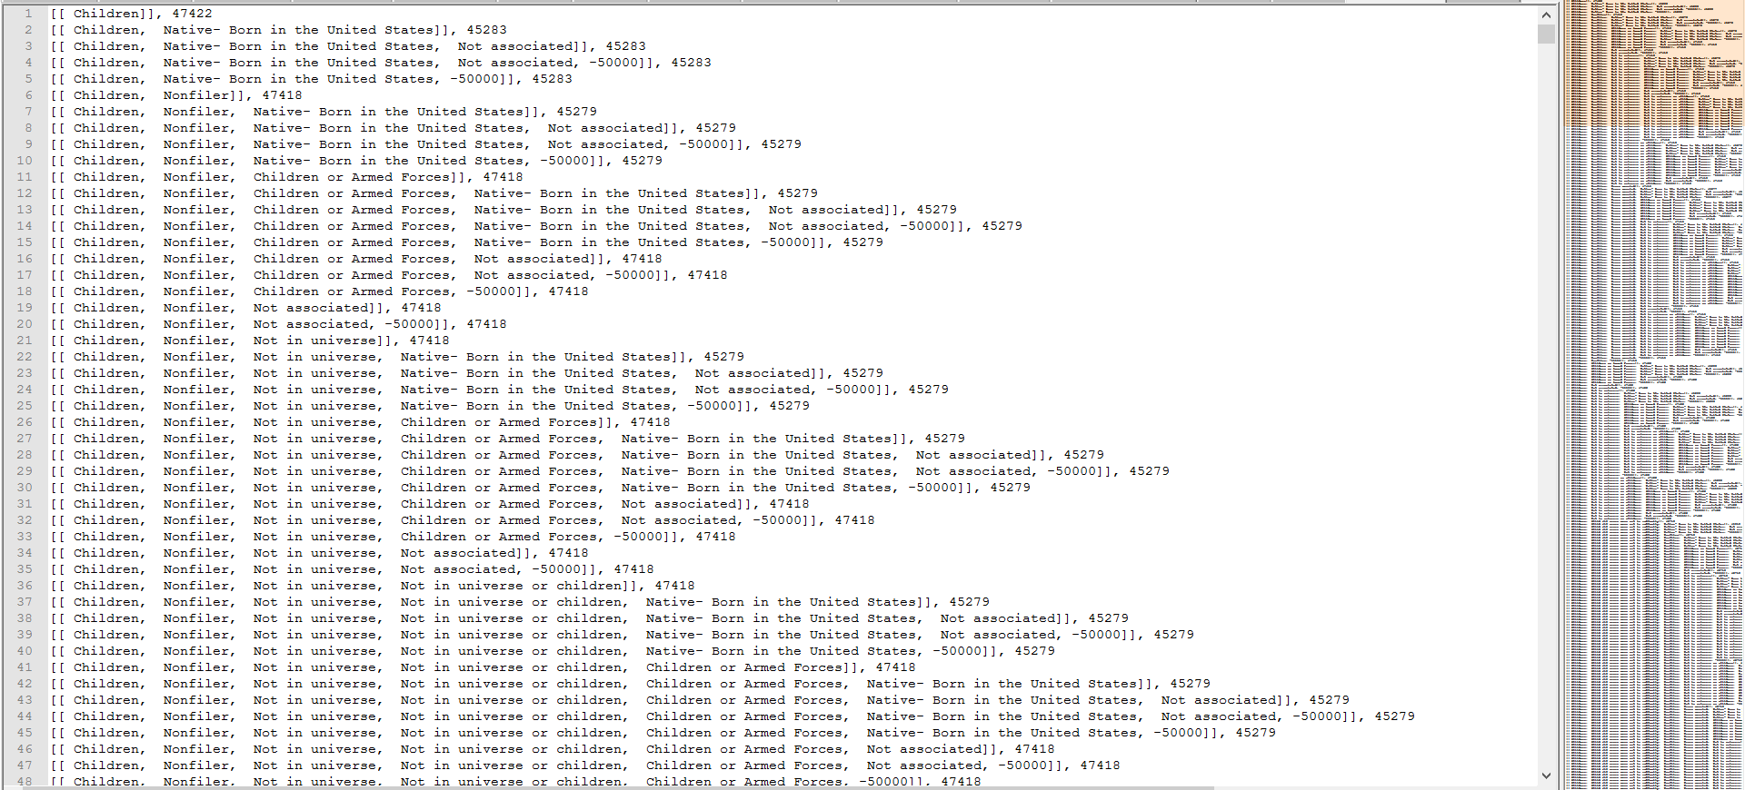
Output rules and frequent patterns from cluster

Slide 12
Rule Mining Process – WEKA
Data preprocessing step to remove continuous data
Apply filter to convert all Nominal and Numeric attributes into Binary
Set the parameters for FP-Growth such as confidence and support

Slide 13
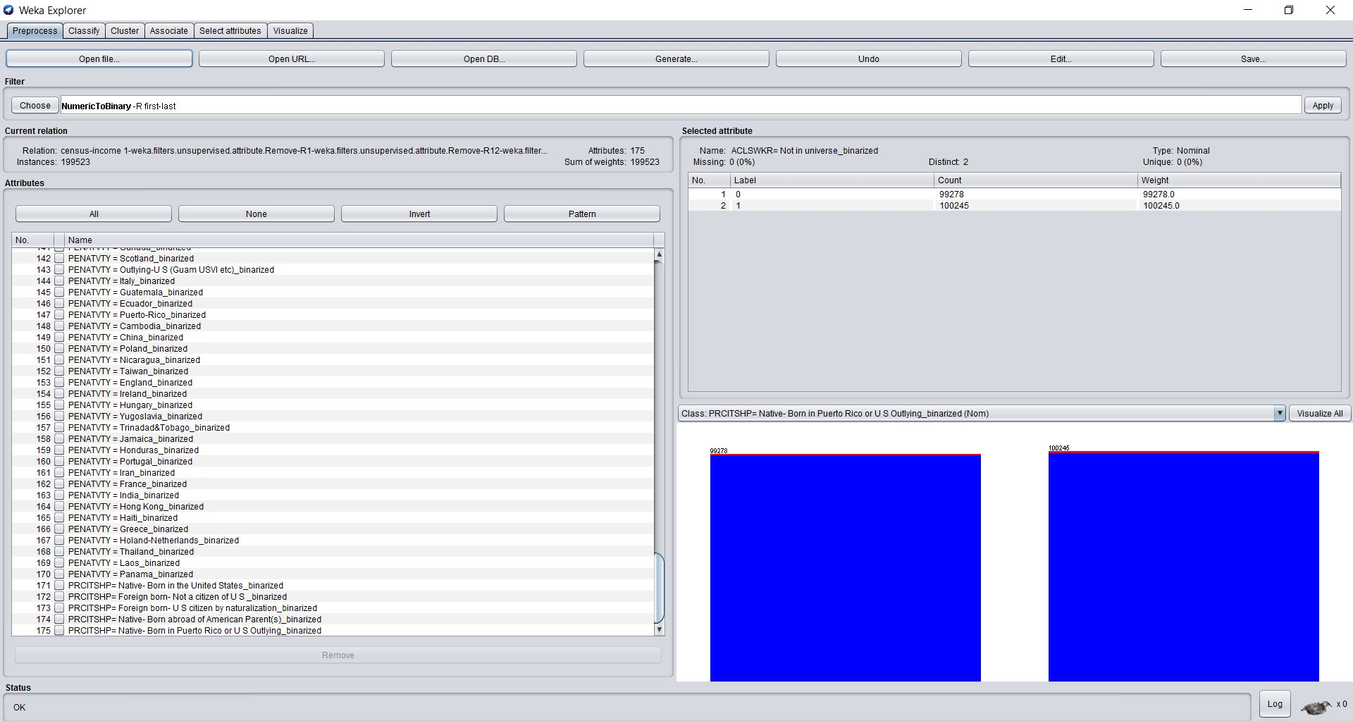
All the attributes binarized

Slide 14
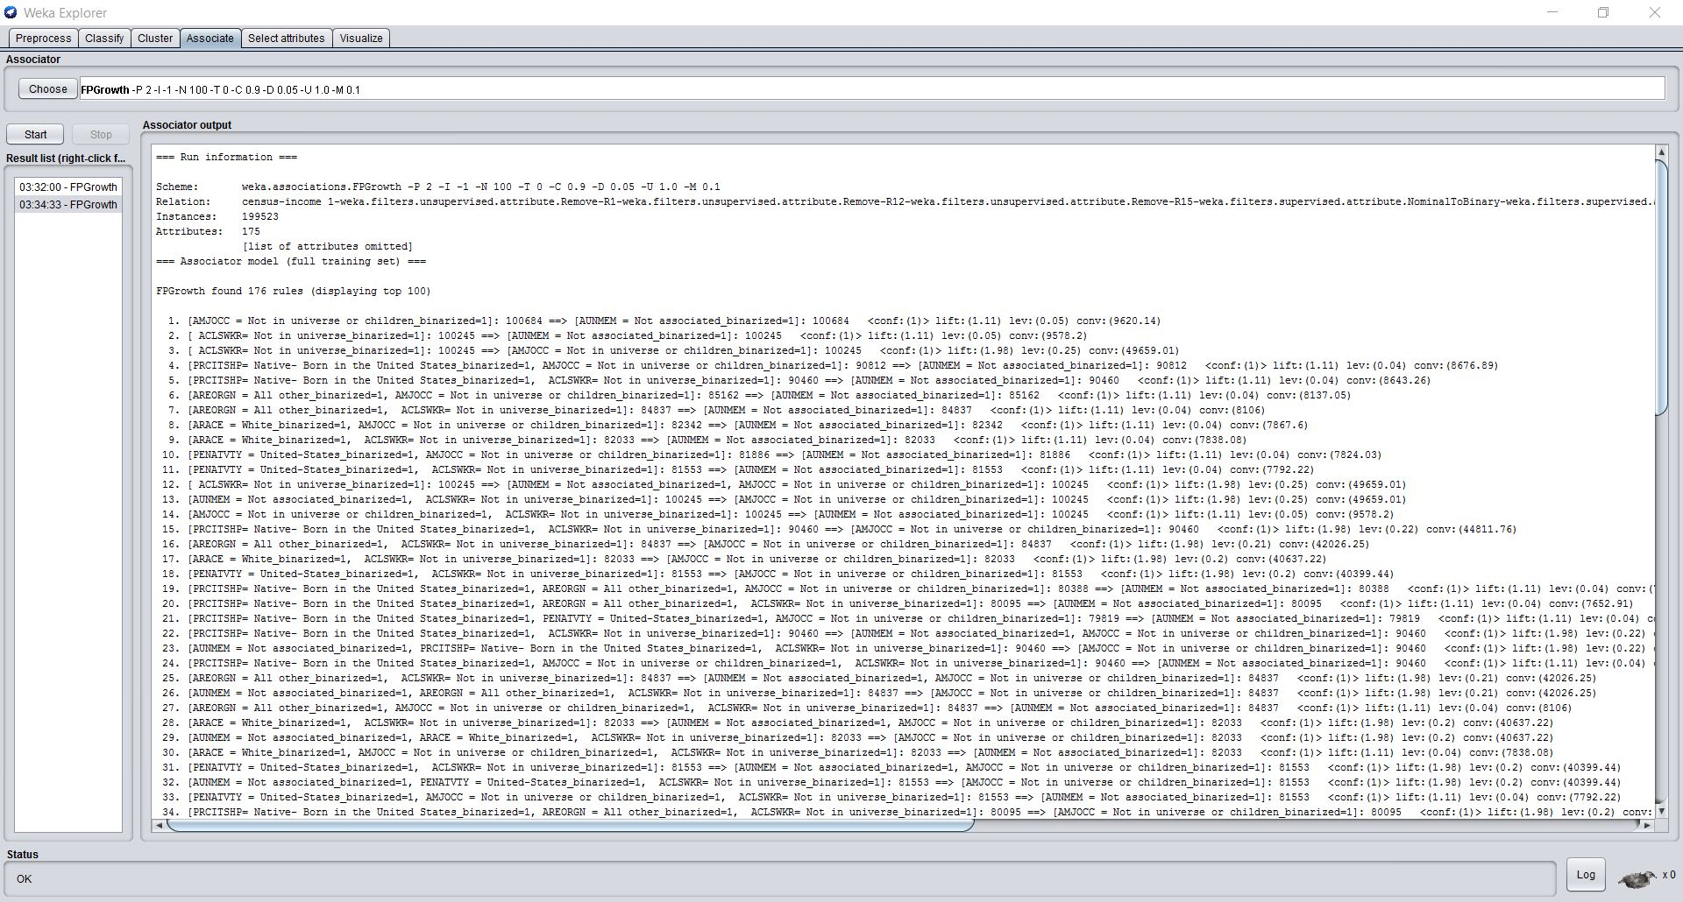
Association rules obtained from WEKA

Slide 15
RESULTING RULES
[ Male, Native- Born in the United States, Not associated, -50000] => [ United-States], 0.9035487464375099
[ High school graduate, Native- Born in the United States] => [ United-States], 0.9311003683241252
[ Married-civilian spouse present, United-States, -50000] => [own business], 0.9860935319508
[ Female, own business, United-States, All other, Native- Born in the United States] => [-50000], 0.9644250706110921

Slide 16
FINDINGS
Most of the united states population works in the private sector. Among the working population most of them are male.
Most of the US citizens are High school graduates.
Average taxable income from a US citizen is less than $50000.
Female Entrepreneurs are taxable less than $50000.

Slide 17
RECOMMENDATIONS
Based on our findings we recommend The US government to focus on Education for citizens and reduce the taxes to encourage more women in Business.

Slide 18
PERFORMANCE COMPARISION
Tool used | WEKA local machine | Local machine using maven [one node] | Local machine using spark submit [one node] | Spark standalone cluster with client deploy [20 cores 4G] | Spark standalone cluster with client deploy [40 cores 4G] | YARN cluster using spark submit
Execution time | Appx. 3 min {reading, applying filter and rule mining} | 24.207 sec | 23.449sec | 16.945 sec | 15.372 sec | 9.449 sec
Size of the data file is 52.7 MB

Slide 19
Thank You

